Slide 1
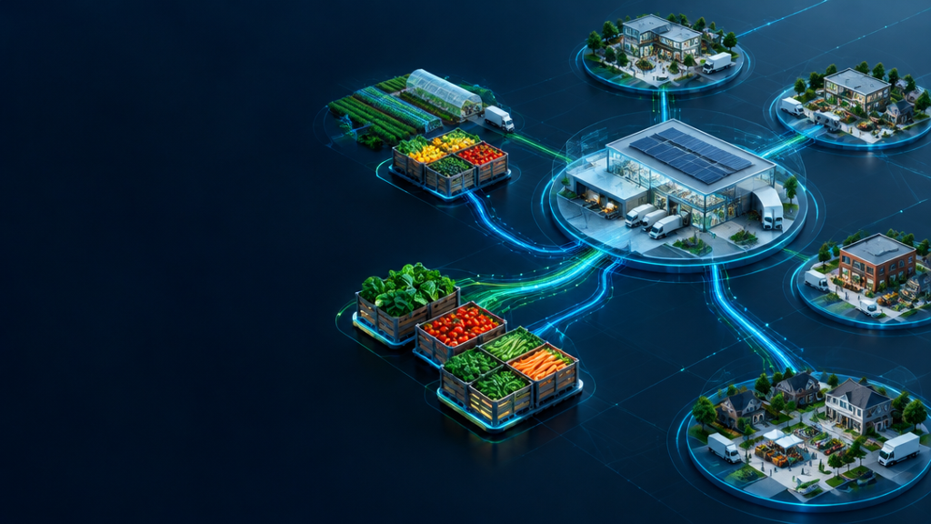
AI-Powered Smart Food
Donation & Distribution System
Connecting surplus food donors with verified NGOs via AI matching & real-time logistics
FULL STACK MERN • UN SDG 2 • LIVE CLOUD DEPLOYED

Slide 2
A mission measured in minutes, not miles
1.3B
828M
8–10%
<5 min
tons of food wasted every year
people face hunger worldwide
of global emissions tied to food waste
digital link from kitchen to shelter
•
Mission
•
SDG alignment
Create a trusted, intelligent redistribution layer that connects commercial kitchens to verified shelters before freshness becomes waste.
02 Zero Hunger
12 Responsible Consumption
13 Climate Action

Slide 3
Redistribution breaks at four critical gaps
•
Manual coordination
•
Perishability
Calls and chats create missed pickups and slow decisions.
Food expires in 4–6 hours without dynamic freshness tracking.
•
Capacity mismatch
•
Verification void
Wrong-sized handoffs cause secondary waste and unmet demand.
Liability fears and fraud risk suppress participation.

Slide 4
One intelligent loop from surplus to safe delivery
•
Urgency Engine
•
AI Matchmaker
•
Secure Logistics
•
Geo Intelligence
Dynamic 0–100 freshness score and live escalation badges.
MCDA ranks proximity, capacity, dietary fit and trust.
Four stages plus OTP create a verified custody chain.
Responsive maps, radius filters and real-time movement.

Slide 5
Architecture built for speed, trust and traceability
REACT 18 SPA • LEAFLET • GLASS UI
EXPRESS REST API • JWT • RBAC
MONGODB ATLAS • 2DSPHERE • AUDIT LOGS
List
Score
Claim
Approve
Track
OTP

Slide 6
A modern stack, deliberately separated by tier
•
Frontend
•
Backend
React 18 • Vite • Router v6
Leaflet • Chart.js • Lucide
Node.js v24 • Express REST
Validator • Morgan Logger
•
Database
•
Security & Cloud
MongoDB Atlas • Mongoose
2dsphere Geo-Indexes
JWT • bcryptjs
Edge hosting • Cloud PaaS

Slide 7

AI Matchmaker: transparent scoring, practical outcomes
SCORE = 35 + 30 + 20 + 15
•
Decision logic
PROXIMITY ≤3 km earns maximum points; ETA adjusts relevance.
CAPACITY Ideal surplus-to-capacity ratio: 0.7–1.3.
DIETARY Veg, vegan, halal and refrigeration safety.
TRUST Accreditation +8; community ratings +7.

Slide 8
Four stages. One verifiable chain of custody.
•
01 PENDING
•
02 ACCEPTED
•
03 PICKED UP
•
04 DELIVERED
Donor lists food; top four NGOs are alerted.
NGO claims with transport and volunteer details.
Donor verifies credentials and issues a 6-digit OTP.
NGO enters OTP; immutable custody record closes.
6-DIGIT OTP → VERIFIED HANDOVER → LOWER FRAUD & LIABILITY

Slide 9
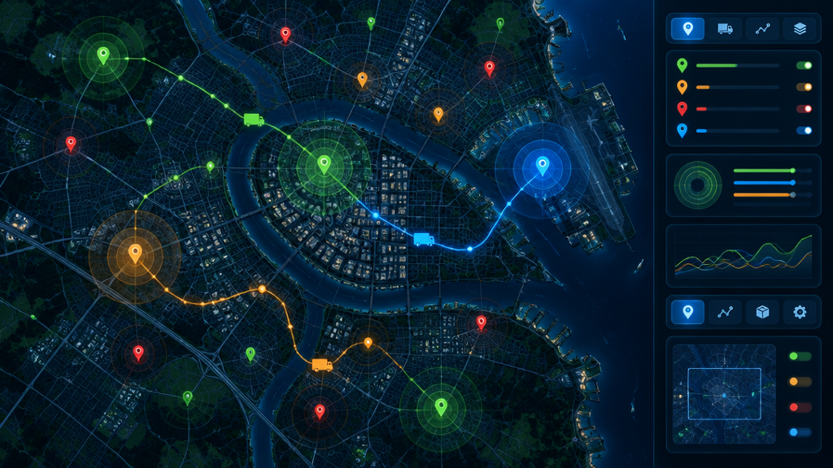
Geospatial mapping meets freshness intelligence
Color-coded pins reveal urgency at a glance. 2dsphere radius queries filter 5 / 10 / 25 km. Shelf-life curves combine elapsed time, food type and storage temperature. Alerts trigger above urgency 85 with under two hours remaining.

Slide 10
Purpose-built portals for every handoff
DONOR PORTAL
NGO / RECEIVER
ADMIN TOWER
2-step listing • AI recommendations • approvals • OTP issue
Map exploration • 1-click claim • tracking • OTP entry
Accreditation • moderation • audit logs • governance

Slide 11
Eight models keep operations coherent and auditable
•
User
•
FoodListing
•
PickupRequest
•
ActivityLog
Roles, GeoJSON, accreditation, stats
Quantity, diet, storage, expiry, urgency
Status, transport, OTP, audit timeline
Immutable governance events
•
Review
•
Category
•
Notification
•
Setting
Community trust and ratings
Food taxonomy and dietary rules
Alerts, claims and escalations
System-level policy controls

Slide 12
Impact that communities — and the climate — can count
1,250+
625 kg
1.56 t
100%
MEALS RESCUED
FOOD SAVED
CO₂e AVOIDED
VERIFIED CUSTODY
Less landfill methane. More meals delivered. Zero custody ambiguity.

Slide 13

Live, cloud deployed and ready to evaluate
•
Production topology
FRONTEND Edge network, responsive desktop + mobile
BACKEND HTTPS cloud service with health monitoring
DATABASE High-availability managed cluster
•
1-click evaluation
Donor • NGO • Admin demo accounts provided

Slide 14
From smart matching to autonomous food rescue
NOW
AI matching + verified logistics
NEXT
IoT cold-chain via BLE / long-range sensors
THEN
Multi-stop VRP with genetic routing
SCALE
Native mobile apps + offline QR
Food waste is an AI and logistics challenge —
and modern full-stack systems can solve it.
THANK YOU

